Slide 1


Graph Databases and Ontology for Recruitment Platform
Zebing LYU
Yaohui Wang
Armando Ponce Sesma
Meri Martirosyan
Venkata Saketh Teki

Slide 2

Content
01
Business objective
- Main goal of the project
- Datacraft
- Established objectives by Datacraft
02
Our Solution
- Demo of the db
- NLP & ontology
03
Recommendations and lessons learned
- Expanding to french publications &Multi-source data gathering
- ML model to auto label to filter out keywords
- Limitations we faced while working on the project

Slide 3
Business Objectives
Basic block of the platform, specifically focusing on the sourcing of PhD candidates
Two sections: employers & candidates
An intermediary: select candidates based on their qualifications, skills, and personal preferences
Keywords related to all AI domains
Regularly usable to update the platform db
Store the imported data on a graph database
Recruitment Platform
The scanR website:
open data resource
over three million theses, publications, and patents & a search engine
to build the platform's database
Datacraft:
a learning & coworking Club
more than 600 high level data science researchers and freelance
Marie Joubert and Julien Capitaine

Slide 4



The company: Datacraft is a learning & coworking Club for data scientists. It allows data scientists and data engineers to share best practices and train with their peers.
Our mentors: Marie Joubert and Julien Capitaine. Marie, the Head of the Datacraft Recruitment Platform Project and Julien, a Data Scientist at Datacraft.
Long term goal: To create a platform that connects junior AI experts with companies looking to hire them.
Source of the data: scanR website and its API
Graph database: Neo4j is our chosen graph database, to handle the interconected data that we extracted.
Ontology objective: Natural Language Processing (NLP) techniques to extract relevant keywords. To obtain more relevant results for our business case and to provide a more complete view of the AI professionals available on the scanR website.

Slide 5

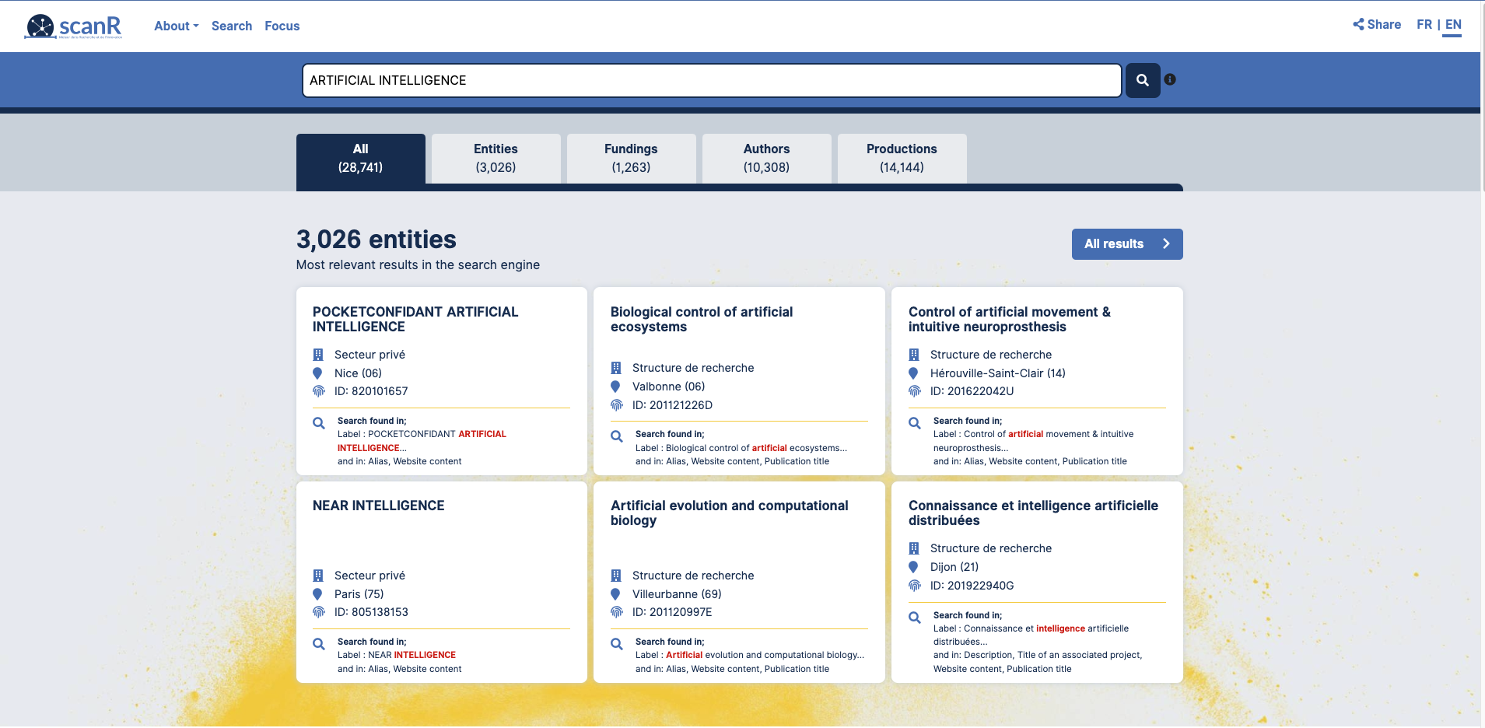
ScanR serves as a useful tool for investigating the research and innovation scene in France
It focuses on four key "Objects": entities, projects, persons, and productions, which comprise publications, PhD theses, and patents.

Slide 6
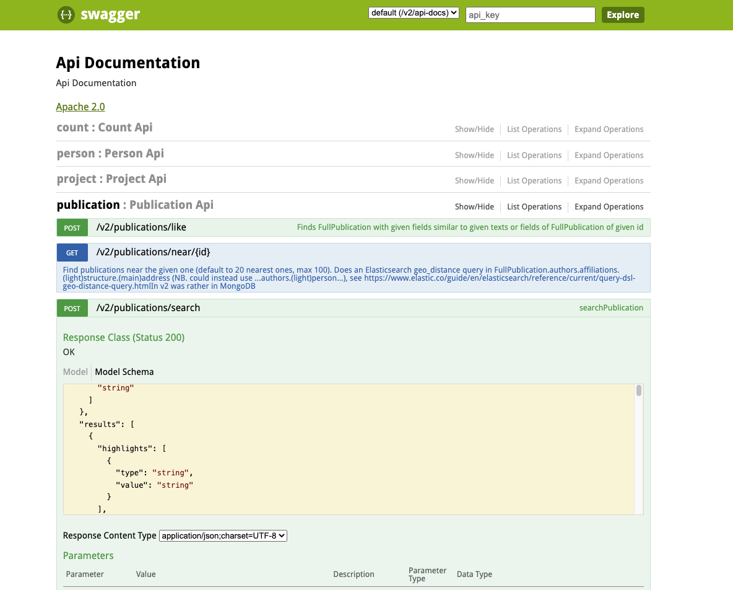
The API (https://scanr-api.enseignementsup-recherche.gouv.fr/api/swagger-ui.html#) enabled us to connect to the scanR database and extract data from it.

Slide 7

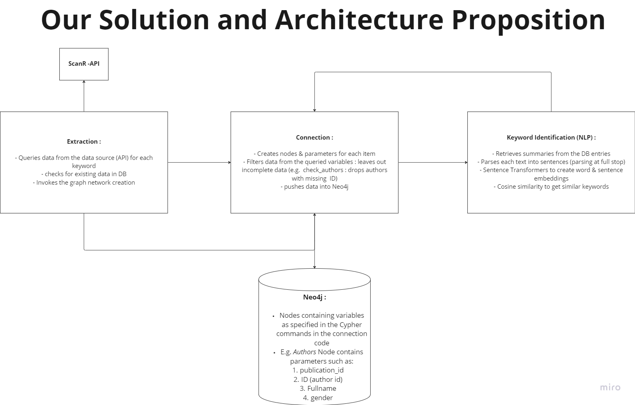
Technical Solution
Demo of the database
01
Database Feautures and Nodes Connection
NLP & ontology
02
Ontology through Sentence Transformers and Cosine Similarity

Slide 8

Neo4j Graph DataBase Demonstration

Slide 9

NLP & ontology
Cosine Similarity
Cosine similarity is Normalised dot product used as a metric to measure the text-similarity between two documents (two vectors) irrespective of their size.
Crucial tools in NLP to extract keywords and enhance the database
SentenceTransformers
An Neural network for state-of-the-art sentence i.e. text embeddings.
These embeddings can be compared using cosine-similarity to find sentences with
a similar meaning.

Slide 10
Steps of keyword extraction and ontology enrichment using NLP
Preprocessing the text and preparing the keyword extractor
Encoding the text and using cosine similarity
The model retrieves a batch of summaries from the dataset
Proceed to conduct several preprocessing steps to filter out numbers etc.
Define the tokenization and lemmatization processes
Using the Vectoriser on lemmatised tokens and fit transform to get the feature names out i.e. keywords in string format
The model encodes the text using a pre-trained transformer-based language model
Find the best described words through the get_bestdesc_words function - cosine similarity between sentences & its ngrams
AI related word extraction - cosine similarity between word pool and primary keynodes
creating the nodes in the db and relate those with the respective publications

Slide 11
Recommendations and lessons learned
Expanding to french publications (requires more linguistic analysis & further research)Multi-source data gathering
ML model to auto label to filter out keywords to avoid data drift
Limitations: inconsistent data, data drift as a result of NLP, lack of accuracy metrics

Slide 12
Limitations and areas of improvement
The information obtained from the website can be incorrect and can lead to errors in our database.
Current NLP analysis was only performed on a batch of publication summaries.
Data sources can be expanded.
It is important to consider aspects such as data privacy and security, while dealing with this data.
The need for ongoing maintenance and updates to ensure the continued accuracy and relevance of the results.

Slide 13
Risks and limitations
Inconsistent data
Limitations
Data drift
Lack of accuracy metrics for predicted keywords

Slide 14
THANK YOU

